Slide 1
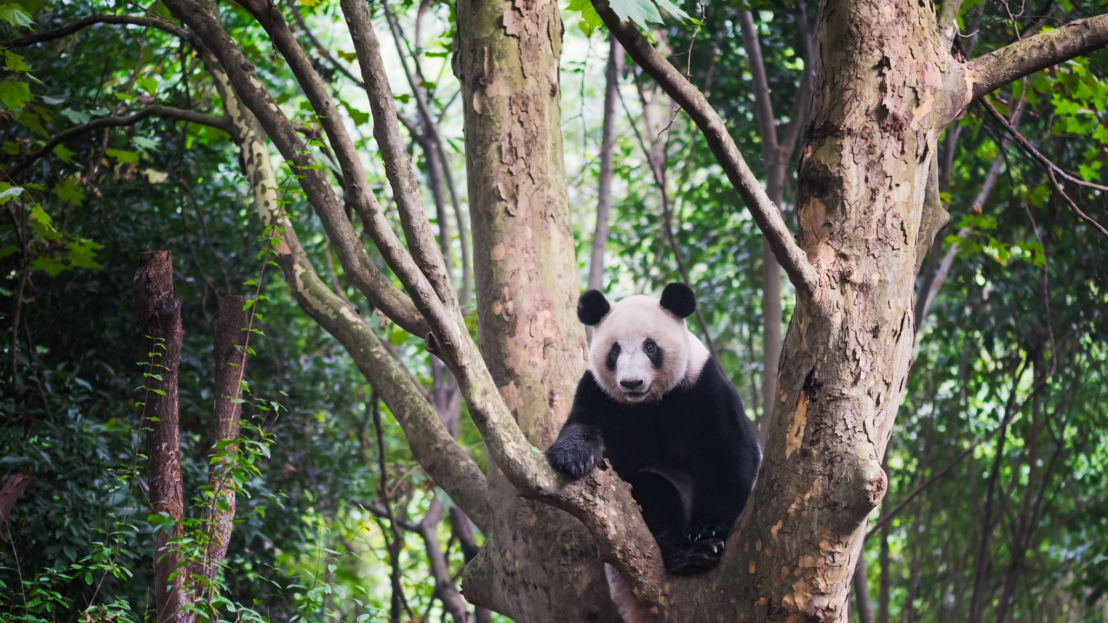
Panda
Nelinka Matoušková

Slide 2
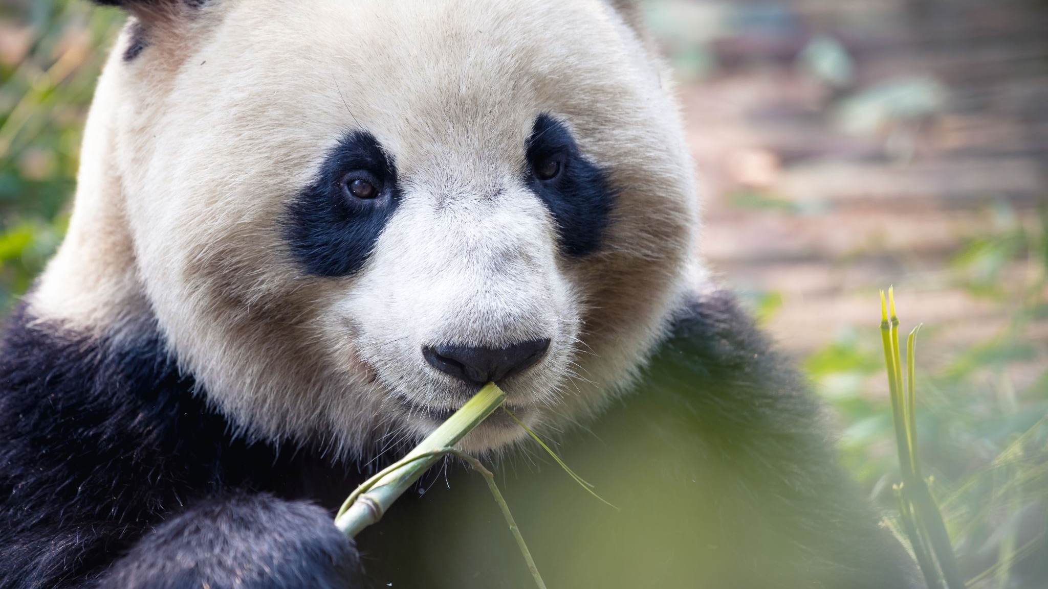
Pandas are black and white.
Panda likes bamboo.

Slide 3
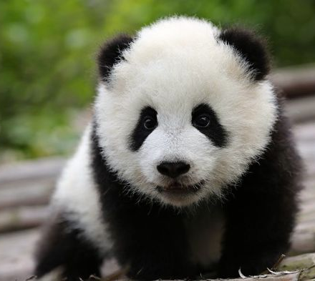
Pandas are beautiful.
Baby pandas are very cute.

Slide 4
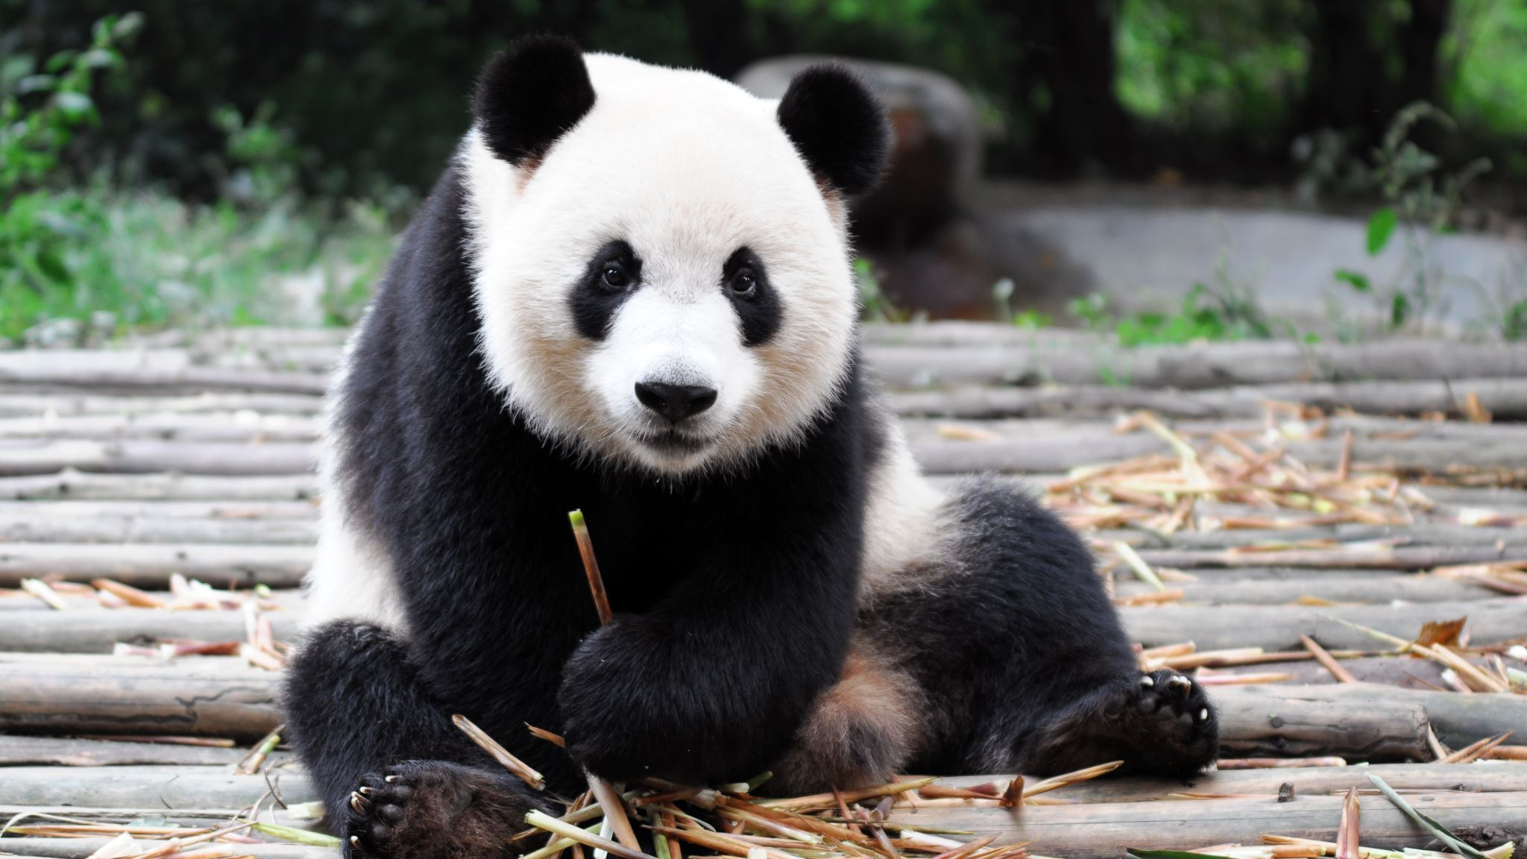
Panda isn't dangerous.

Slide 5
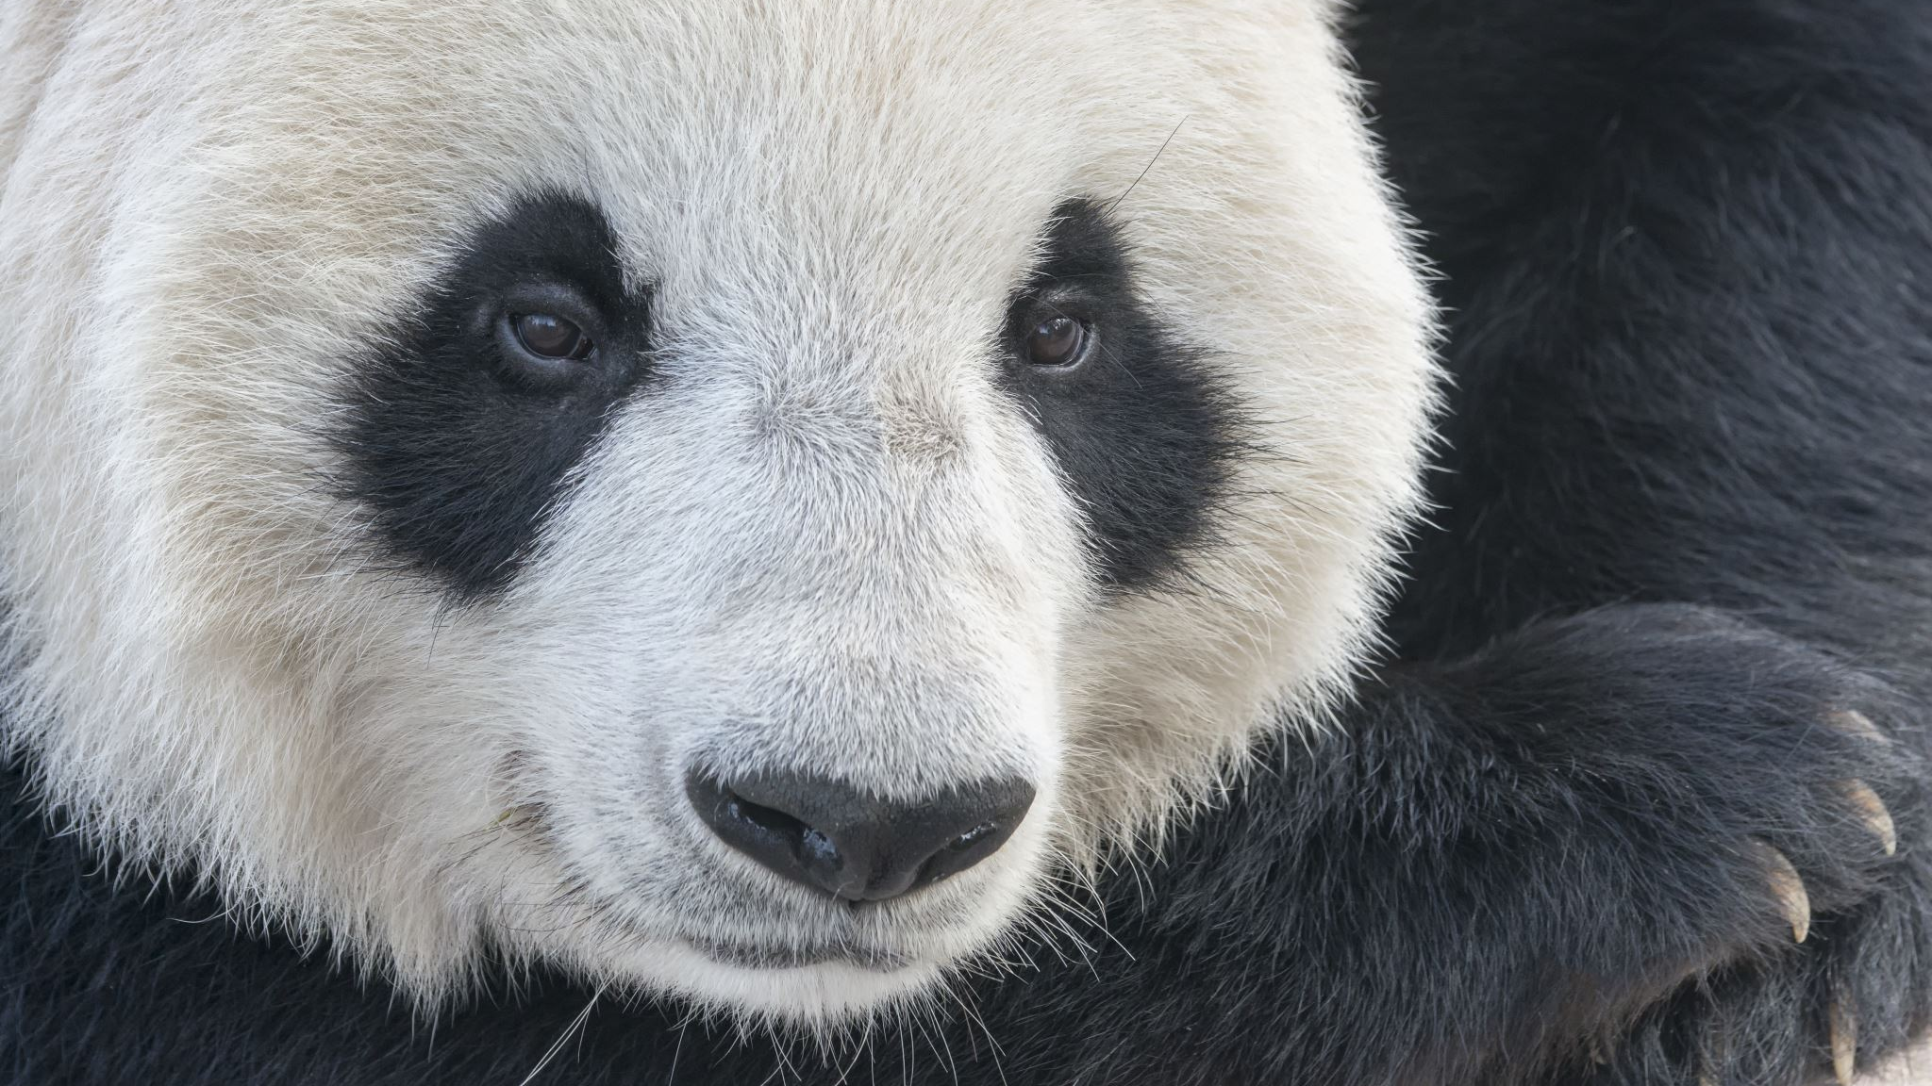
Pandas live in Asia.
I love pandas.

